Slide 1

EVALUATION METRICS

Slide 2

PERFORMANCE EVALUATION METRICS -
ACCURACY
So far we have just been evaluating the performance of our algorithms based on accuracy
#correct Prediction
Total # of Predictions
Data Squad | Supervised Learning

Slide 3
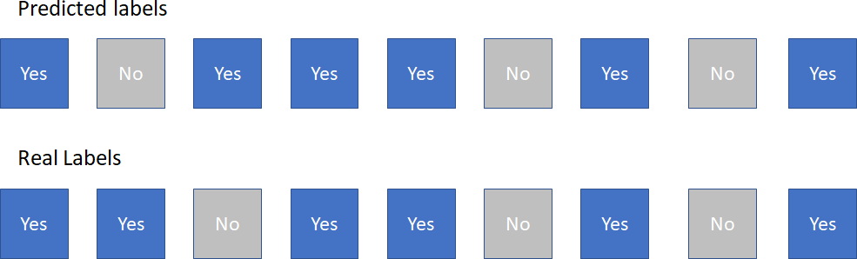
PERFORMANCE EVALUATION METRICS -
ACCURACY
So far we have just been evaluating the performance of our algorithms based on accuracy
#correct Prediction
Total # of Predictions
Data Squad | Supervised Learning

Slide 4
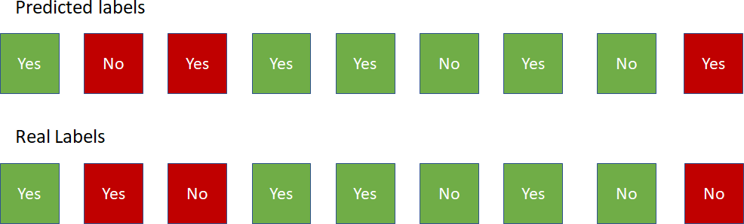
PERFORMANCE EVALUATION METRICS -
ACCURACY
#correct Prediction
Total # of Predictions
So far we have just been evaluating the performance of our algorithms based on accuracy
Data Squad | Supervised Learning

Slide 5
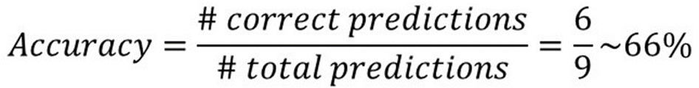
PERFORMANCE EVALUATION METRICS -
ACCURACY
#correct Prediction
Total # of Predictions
So far we have just been evaluating the performance of our algorithms based on accuracy
Data Squad | Supervised Learning

Slide 6

PERFORMANCE EVALUATION METRICS -
ACCURACY
How can accuracy be deceptive?
Imbalanced Datasets
Importance of incorrect prediction of a certain class
#correct Prediction
Total # of Predictions
Data Squad | Supervised Learning

Slide 7
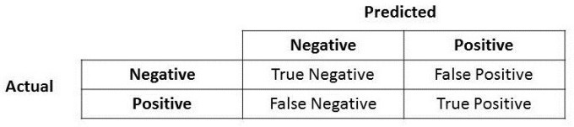
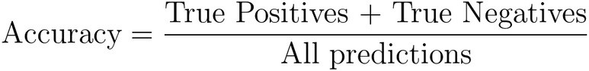

PERFORMANCE EVALUATION METRICS –
CONFUSION MATRIX
Data Squad | Supervised Learning

Slide 8



PERFORMANCE EVALUATION METRICS –
CONFUSION MATRIX
Type I error
Type II error
Data Squad | Supervised Learning

Slide 9
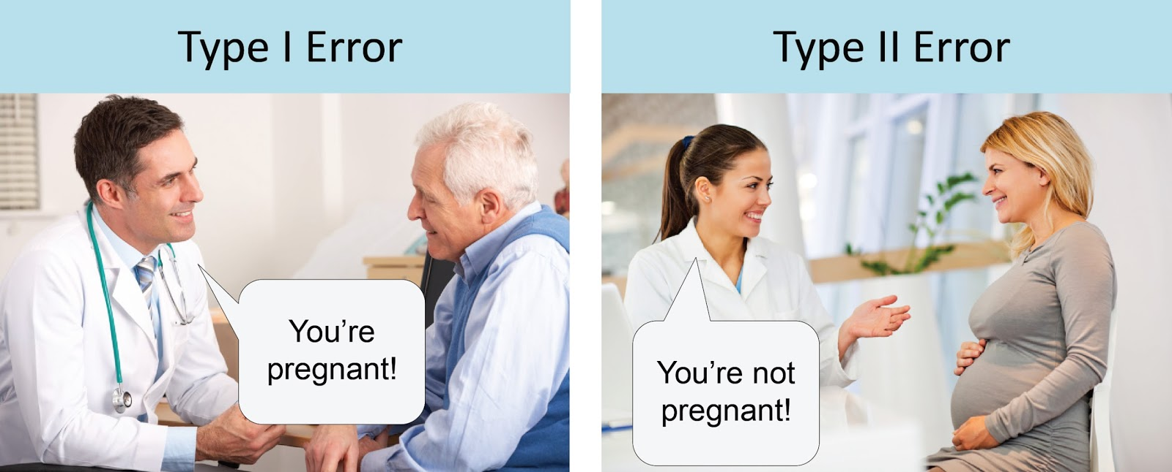
PERFORMANCE EVALUATION METRICS –
CONFUSION MATRIX
Type I error
Type II error
Data Squad | Supervised Learning

Slide 10
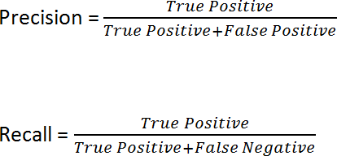
PERFORMANCE EVALUATION METRICS –
CONFUSION MATRIX
Data Squad | Supervised Learning

Slide 11


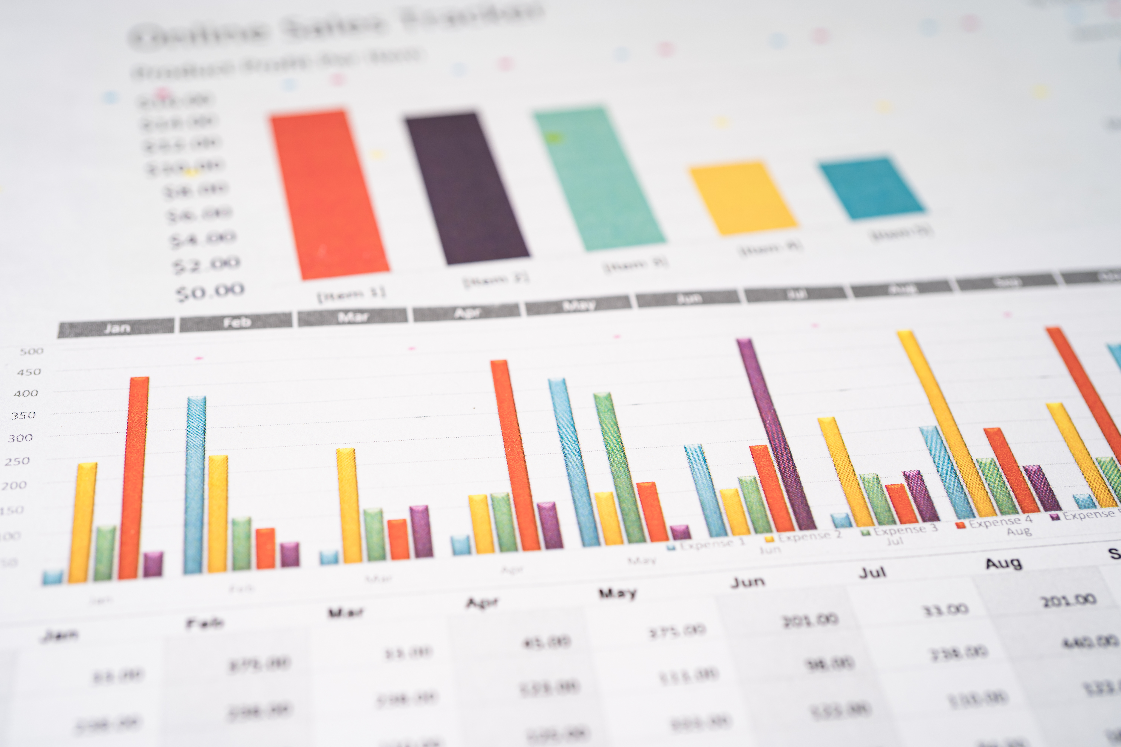

PERFORMANCE EVALUATION METRICS - PRECISION & RECALL
Let's describe these two concepts through words & intuition
Precision of Class A:
From all the datapoints I predicted to be "A", how many were A?
Example: From a universe of 1000 people, we predicted 10 had coronavirus. In fact only 8 out of these 10 were actually infected.
Precision = 8/10 == 80%
Data Squad | Supervised Learning

Slide 12


PERFORMANCE EVALUATION METRICS - PRECISION & RECALL
Let'sdescribethesetwoconceptsthroughwords&intuition
Recall of Class A:
Fromallthedatapointsthattrulywere"A",howmanydidwepredict?
Example: From a universe of 1000 people, 100 are actually infected with coronavirus(wedonotknowthis,ofcourse)wecorrectlypredictedthat50 peoplehadthevirus
Recall=50/100==50%
Data Squad | Supervised Learning

Slide 13



PERFORMANCE EVALUATION METRICS - PRECISION & RECALL
Which one should we prioritize?
DEPENDS ON THE PROBLEM
However, we have to learn how to decide which one we want to prioritize: Predict if a patient has cancer
Brute Force Precision: only claim the patient has cancer if every single test comes up true multiple times in a row
Brute Force Recall: assume that a patient has cancer "to play it safe" before more tests come in
Data Squad | Supervised Learning

Slide 14


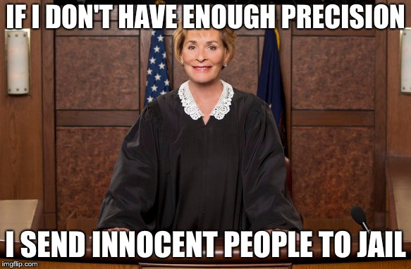
PERFORMANCE EVALUATION METRICS - PRECISION & RECALL
Which one should we prioritize?
Data Squad | Supervised Learning

Slide 15

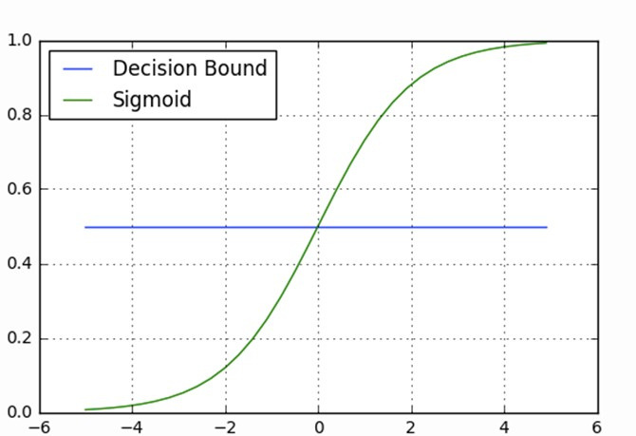
PERFORMANCE EVALUATION METRICS - LOGISTIC REGRESSION
How do you relate the decision boundary to precision/recall in the logistic regression algorithm?
Class 1
Sigmoid(z)
Class 0
z
Data Squad | Supervised Learning

Slide 16
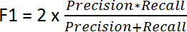
PERFORMANCE EVALUATION METRICS - F1 SCORE
A Trade-off between both such that the algorithm doesn't improve too much one of them at the expense of the other
Data Squad | Supervised Learning

Slide 17
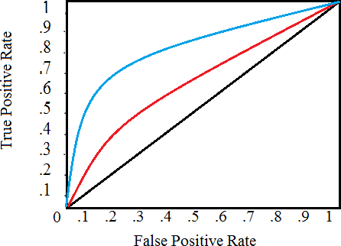
PERFORMANCE EVALUATION METRICS - ROC CURVE
It is a plot of the false positive rate (x-axis) versus the true positive rate (y-axis) for a number of different candidate threshold values between 0.0 and 1.0. Put another way, it plots the false alarm rate versus the hit rate.
Data Squad | Supervised Learning

Slide 18

ANY QUESTIONS ?

